Slide 1

MIS 547
Cloud Computing

Slide 2

Admin
Assignment 3 Due Sunday @ midnight
01
Quiz 3 Due Sunday @ midnight
02
Group formations by EOD today
03
Lectures 6, 7, 8 online only
04

Slide 3
Storage
File, Object, and Block Storage
Agenda
Cloud storage
Quiz 1 Review
Quiz 2 Review

Slide 4
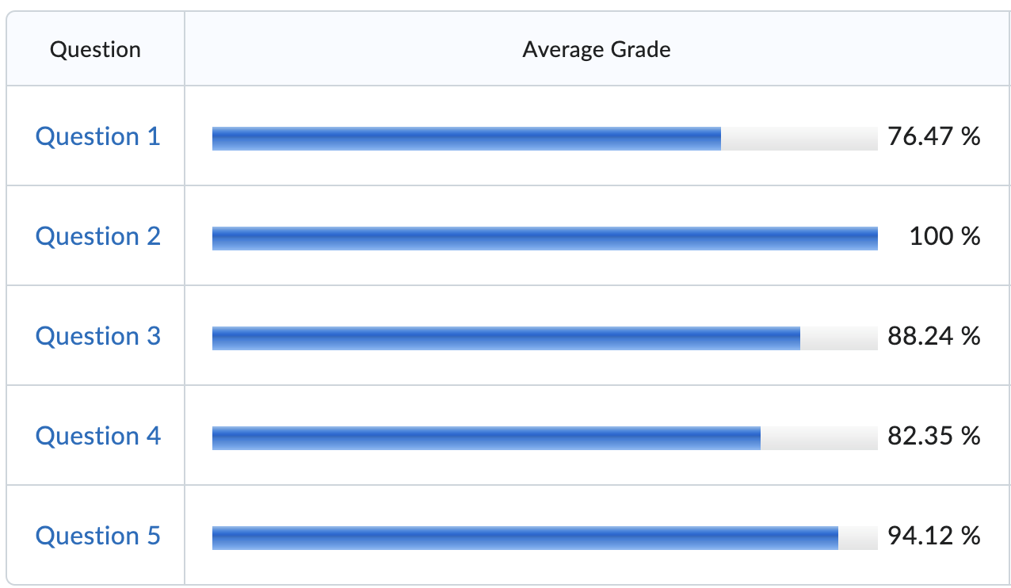
Quiz 1 Review

Slide 5
Quiz 1 Review
Q1: Which cloud deployment model gives you the most control over your cloud resource utilization and resource configuration?
Software as a Service
Platform as a Service
Infrastructure as a Service
Private cloud

Slide 6
Quiz 1 Review
Q2: Which of the following is NOT true of multi-tenancy?
In a multi-tenant environment, multiple customers share the same physical resources
Multi-tenant environments will respond elastically to customer demand to provision resources as required by customers.
In multi-tenant environments, the security of services is left entirely up to the customer.
A multi-tenant environment is comprised of a pool of shared resources that is dynamically allocated to customers.

Slide 7
Quiz 1 Review
Q3: Which of the following is NOT true of cloud computing costs?
In cloud computing, by renting time and use of resources, customers exchange capital expenses for operational expenses.
The majority of organizations who have adopted cloud computing strategies have seen an increase in cloud spending in the last 12 months.
Avoidable cloud spend, also known as cloud waste, remains a challenge for ~90% of organizations who have adopted cloud computing as part of their business compute strategy.
Cloud waste cannot be attributed to a lack of skills within the organization; rather, cloud waste is mostly a function of bandwidth costs.

Slide 8
Quiz 1 Review
Q4: A performing arts organization has the following resources:
A ticketing application server and database hosted in an offsite data center that is managed by a contracted service provider, which they access via a VPN.
A web server running in AWS that they hire an outside consultant to maintain.
Which of the following best describes this organization’s cloud deployment model:
Private cloud
Public cloud
Hybrid cloud
Multi-cloud

Slide 9
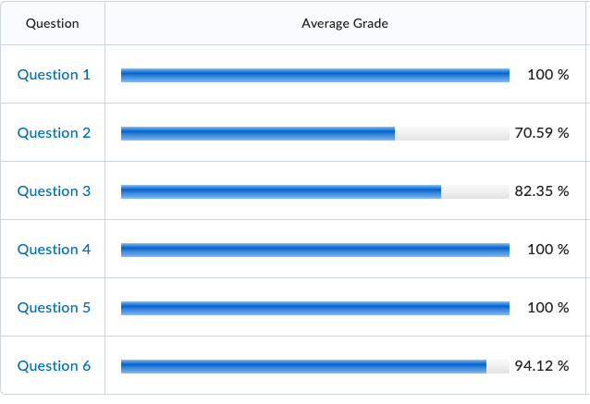
Quiz 2 Review

Slide 10
Quiz 2 Review
Q1: Containers differ from virtual machines in that:
Virtual machines run directly on the host operating system.
Containers run directly as processes on the host operating system.
Compared to containers, virtual machines have a light footprint.
It is possible to pack a higher number of VMs than containers on the same physical machine.

Slide 11
Quiz 2 Review
Q2: A containerized application will contain each of the following except:
Application code
Container runtime
Application dependencies (libraries, etc.)
Host operating system dependencies

Slide 12
Quiz 2 Review
Q3: Which of the following is true of hypervisors:
Type 1 hypervisors are known as hosted hypervisors and are used for end-user virtualization.
Type 1 hypervisors provide lower latency to users because they take advantage of the underlying operating system's APIs, services, and drivers.
Hypervisors are created to run a specific guest OS- when we create an Ubuntu image, that image is instantiated on a server with an underlying hypervisor made specifically to run Ubuntu.
Hypervisors allow us to quickly move virtual machines from one host to another, reducing down time in the event that an underlying host is unavailable.

Slide 13
Quiz 2 Review
Q4: Why do container images need to be built for specific architectures (e.g., ARM, x86 Linux, x86 Windows, etc.)
Containers share the operating system kernel with other containers and the host. Therefore, kernel compatibility requires container images to be built for a particular architecture & OS family.
Container runtimes emulate the underlying hardware, so container images need to be built to work closely with the underlying hardware.

Slide 14
Quiz 2 Review
Q5: When you create a virtual machine in the cloud, by default, you are the only customer using the physical hardware that supports your VM.
True
False

Slide 15
Quiz 2
Q6: To reduce complexity, it is best practice to use the same SSH key across different clouds and services.
True
False

Slide 16
Lecture 5: Cloud Storage
Notes:
What might we want to store in the cloud?

Slide 17
Types of Cloud storage
Object storage
File storage
Block storage

Slide 18

File Storage

Slide 19
Cloud File storage
Stored in units of files
Hierarchical
Familiar in end-user computing

Slide 20
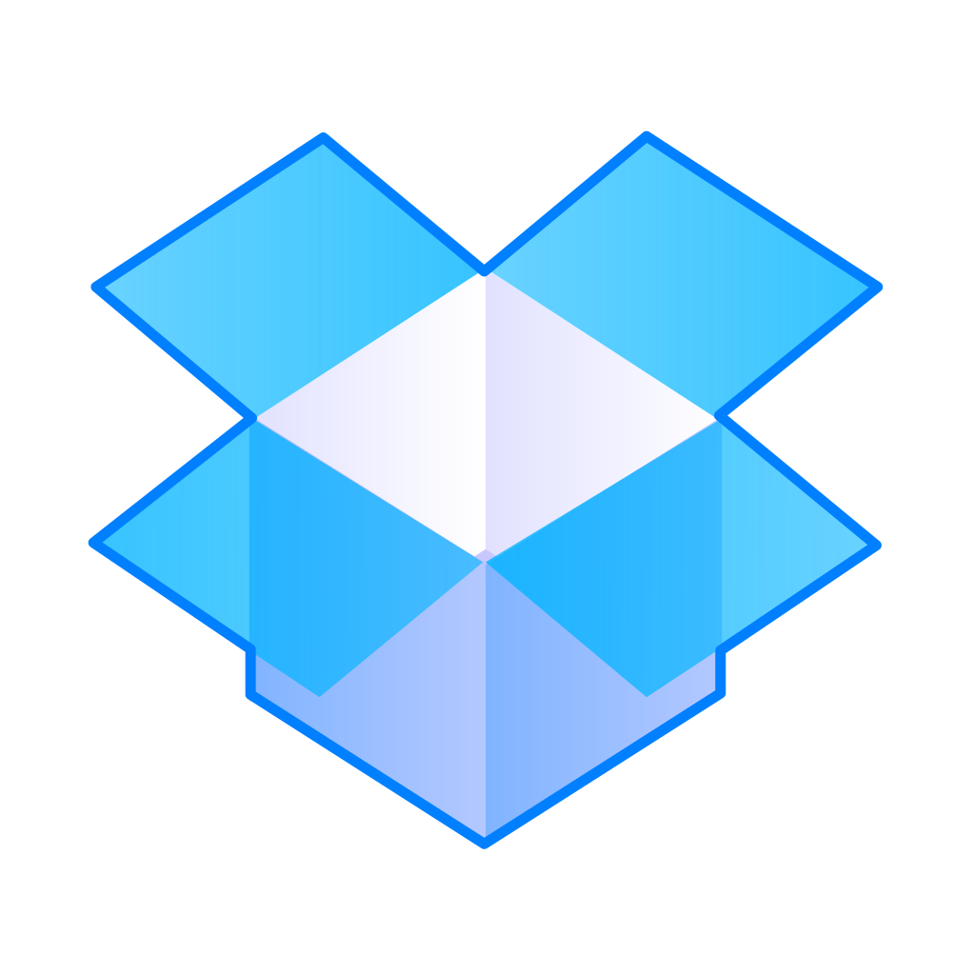
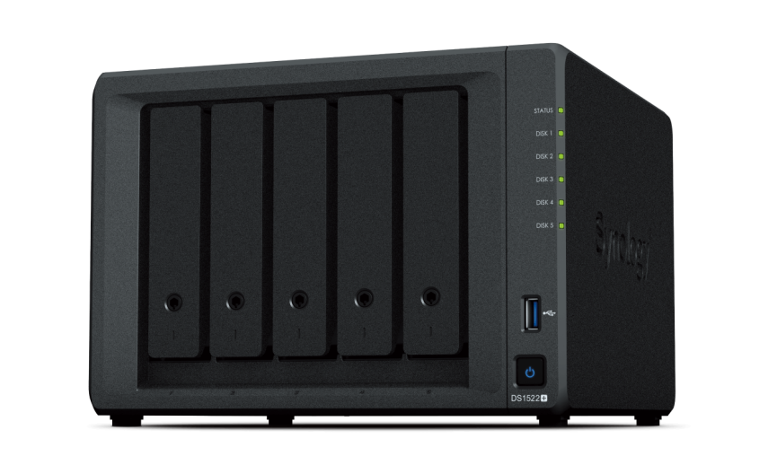
Cloud File Storage
Popular in end-user (consumer) technologies
IT sysadmins may be familiar with Network Attached Storage (NAS)
Many users access files saved on one (or multiple) NAS devices
Users map their machines to the NAS and then access centralized files
Permissions management handled by IT

Slide 21



Cloud File Storage
File management handled by administration
Use permissions groups to manage security and access
Easy to migrate on-prem file stores to cloud file storage

Slide 22


How to Use Cloud File Storage
Mount to VM
Mount to container
Mount to on-prem file server
NFS or SMB
TCP/IP

Slide 23
File Storage, Cont.
Pros
Easy to manage on a small scale
Familiar to most users
Users can manage their own files
Allows access rights/ file sharing/ file locking to be set at user level
Cons
Challenging to manage and retrieve large numbers of files
Hard to work with unstructured data
Expensive at large scales
Latency

Slide 24
Interesting Cloud File Storage Developments
Google Cloud FUSE
FUSE: Linux Filesystem in Userspace Interface
Allows for locally mounting cloud file storage to your machine/VM/container
Gaining popularity in ML/AI for ability to store data, models, checkpoints, logs directly in cloud storage

Slide 25
Use Cases for File storage
Collaboration on documents
Backup and recovery
Archiving
Access to shared files for vM deployment

Slide 26
Things to Consider for Migration
Does your organization need to purge older files?
Should your cloud files mirror your on-prem permissions?
What are the requirements re: latency?
What tier of storage do you need?
Capacity
Reads/writes
IOPS

Slide 27



File Storage Options
AWS Elastic File System
GCP Filestore
Azure Files

Slide 28
Amazon Elastic File System (EFS)
Storage class | Designed for | Availability | Availability zones | Other considerations
EFS Standard | Frequently accessed data requiring the highest durability and availability. | 99.99% | >=3 | None
EFS Standard–Infrequent Access (IA) | Long lived, infrequently accessed data requiring the highest durability and availability. | 99.99% | >=3 | Per GB retrieval fees apply.
EFS One Zone | Frequently accessed data that doesn’t require highest levels of durability and availability. | 99.90% | 1 | Not resilient to the loss of the Availability Zone.
EFS One Zone-IA | Long lived, infrequently accessed data that doesn’t require highest levels of durability and availability. | 99.90% | 1 | Not resilient to the loss of the AZ. Per GB retrieval fees apply.

Slide 29
Common Considerations for Cloud Costs
Number of operations
Availability requirements (SLA)
Frequency of access

Slide 30
Object Storage

Slide 31

Object Storage
Unit of storage is an object, each object is stored in a bucket
Objects can be any size or format
Good for unstructured data
Flat structure

Slide 32
Object Storage
Each object has key parts:
Identifier
A unique ID that allows the object to be located
Data
The actual data itself
Metadata & attributes
ID, access controls, creation date, size, etc.

Slide 33
Object Storage
Exabyte Scalability
Scale-out architecture
Customizable metadata
High throughput performance

Slide 34
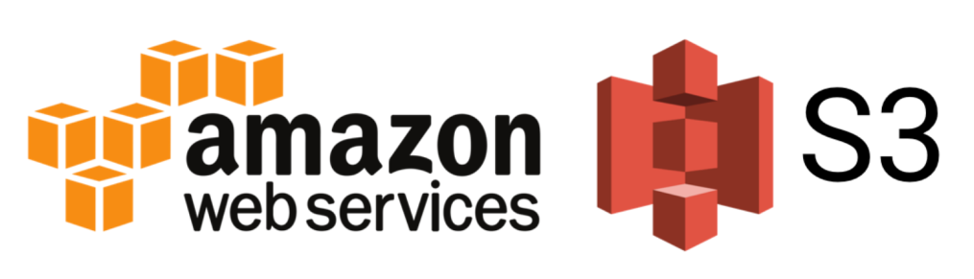
Object Storage
Amazon Simple Storage Service (S3)
Multi-tenant object storage with an HTTP REST API

Slide 35
Amazon S3
31 regions
99 availability zones
100 million requests per second
400 terabits per second
280 trillion objects stored

Slide 36
Object Storage, Cont.
Pros
Cons
Handles large amounts of unstructured data
Affordable consumption model
Unlimited scalability
Uses metadata
Advanced search capabilities
Limited granularity of access controls
Cannot modify a single portion of a file (objects are immutable)

Slide 37
Object Storage Use Cases
IoT data management
Email archiving
Backup and recovery
Replicate video streaming data in global locations
Digital archiving
Don’t ask “when do we use object storage?”,
ask “when do we not use object storage?”

Slide 38

Block Storage

Slide 39
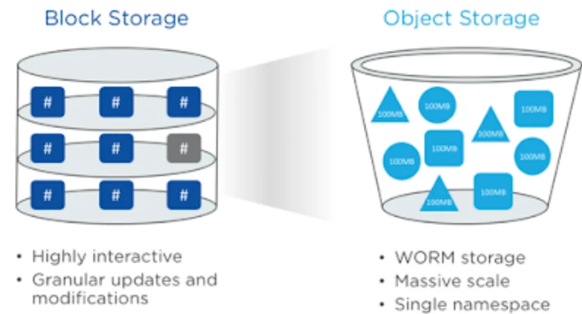
Block Storage
Stored in units of blocks
Block + unique identifier for retrieval
Distributed among multiple environments and reassembled for user
Like USB drive or external hard drive
Source: Ridge Cloud

Slide 40
Block Storage
Pros
Cons
Fast
Reliable
Easy to modify
Lack of metadata
Not searchable
High cost

Slide 41
Block Storage Use cases
Databases
Email servers
Virtual machine file system (VMFS) volumes

Slide 42
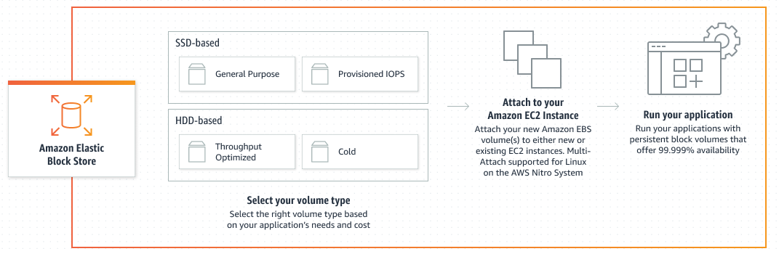
Amazon Elastic Block Store (EBS)
Provides block-level storage volumes to use with EC2 Instances
Like an external hard drive, but can exist on its own without being attached to EC2 instance

Slide 43
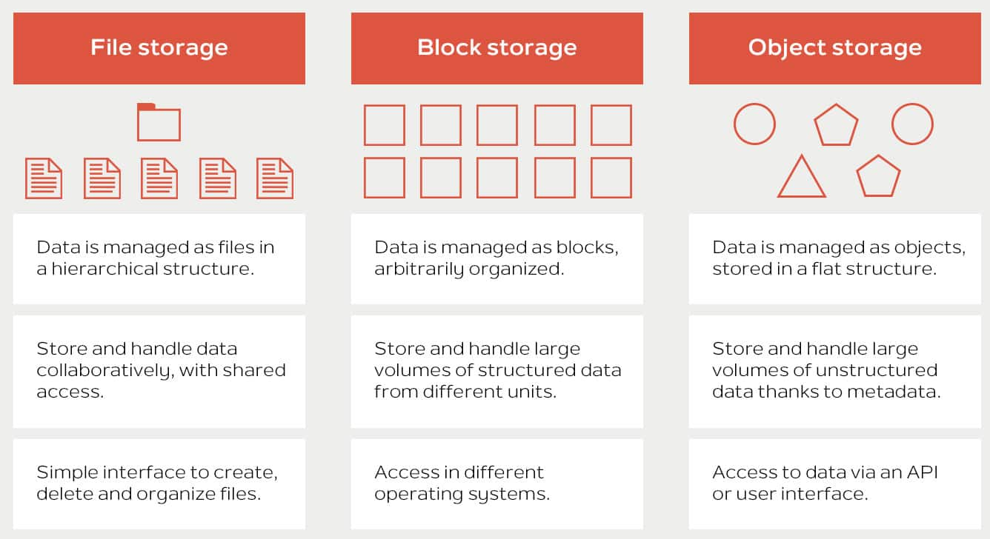
Comparing Storage Types
Source: Stackscale

Slide 44
Comparing Storage Types
 | Object | Block | File
Storage method | Unstructured data in non-hierarchical buckets | Blocks of fixed size, reassembled on demand | File-level protocols and permissions
Storage capacity | Unlimited | Limited | Limited
Retrievability | Customizable | Data lookup table | More difficult
Metadata | Unlimited and customizable | Very little metadata | Limited metadata
Performance | Minimal latency | High performance, low latency, rapid data transfer | High performance for shared file access
Physical storage | Distributed across multiple nodes | Distributed across SSDs and HDDs | On-prem NAS or on top of physical block storage
Storage use cases | Application assets, logs, analytics, backups, video, audio, images, data archives, ML data sets, storage for serverless and microservice apps | Critical system data, database storage, mission critical application data, RAID volumes | User-level file storage and collaboration

Slide 45
Using Cloud Storage
S3 & Spaces Buckets

Slide 46
Interfacing with Object Storage
Object storage is usually accessed via APIs
Software Development Kits (SDKs) let us interact with cloud API calls in our applications
boto3 is the Python SDK for AWS
boto3 allows Python developers to write software that makes use of services like S3 and Amazon EC2

Slide 47
Interfacing with Object Storage
Spaces is DigitalOcean’s object storage offering.
Has full parity with S3
Can use boto3 to interface with Spaces

Slide 48
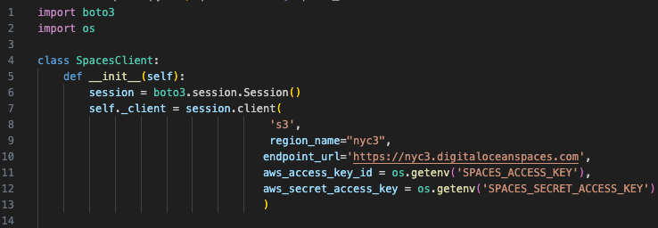
Using boto3

Slide 49
Using boto3
Generate the Access Key ID and Secret Access Key in the DigitalOcean Cloud Console.

Slide 50
Using boto3
Use os.getenv to read Key ID and Secret as environment variables

Slide 51

Environment Variables
Ways to persist environment variables
In your project directory in a .env or .envrc file
ADD .env AND .envrc TO YOUR .gitignore!!
Never check in to source control!

Slide 52
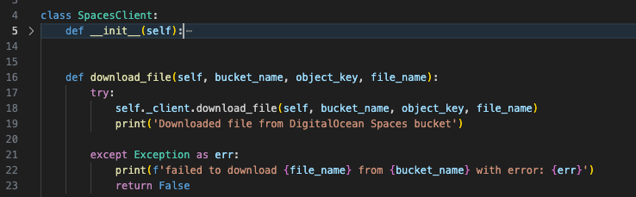
Using Boto3

Slide 53
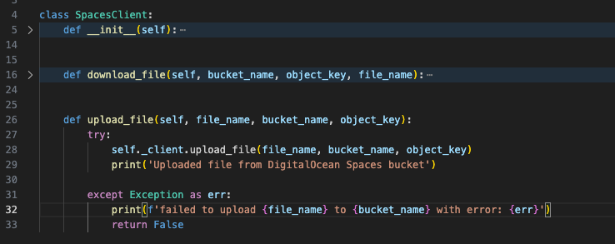
Using Boto3

Slide 54
Questions, Comments, Concerns

Slide 55
Land Acknowledgement Statement
We respectfully acknowledge the University of Arizona is on the land and territories of Indigenous peoples. Today, Arizona is home to 22 federally-recognized tribes, with Tucson being home to the O’odham and the Yacqui. Committed to diversity and inclusion, the University strives to build sustainable relationships with sovereign Native Nations and Indigenous communities through education offerings, partnerships, and community service.

